Slide 1
Deprecated Functions – Perform Scan
AVCDL-Implementation-6.1.3
Charles Wilson
Staff Product Cybersecurity Architect
version 2
2026-04-13
Notes:
Script:
I'm Charles Wilson, staff product cybersecurity architect at Torc Robotics.
This presentation will cover the Deprecated Functions Perform Scan activity.

Slide 2
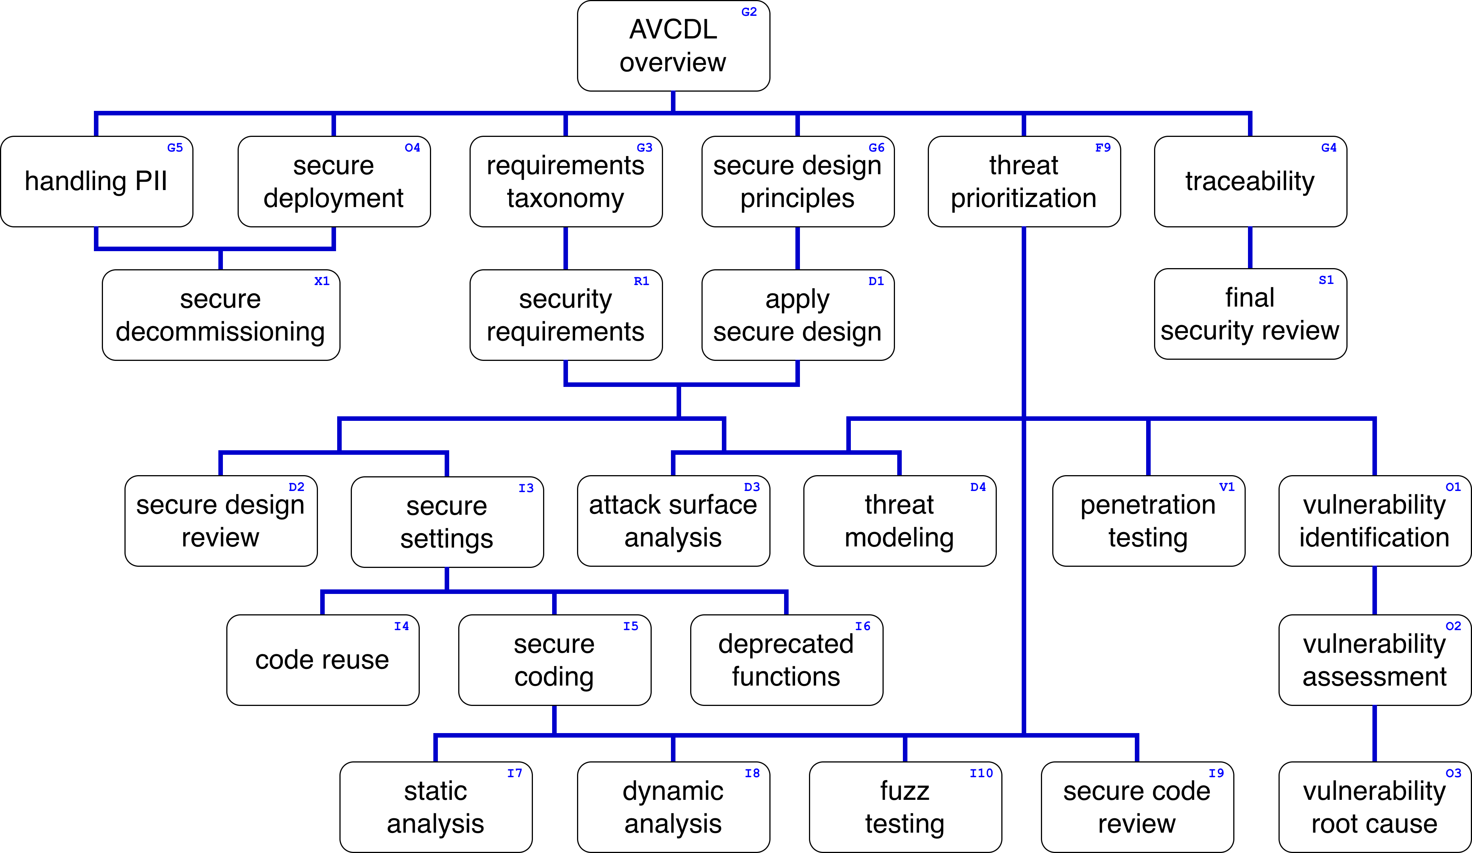
Training Path
Notes:
Script:
This diagram shows the overall AVCDL training path.
If you're taking this training, it's assumed that you've already completed the AVCDL Overview training,
and additionally, that you've completed the
Requirements Taxonomy
Security Requirements
Secure Design Principles
Apply Secure Design
Secure Settings
Deprecated Functions Overview
Deprecated Functions – Identify Functions
and
Deprecated Functions – Incorporate Scan
trainings.
This training will cover Deprecated Functions Scanning.

Slide 3
Workflow
Notes:
Script:
Before getting into how we perform the scanning activity, let's briefly review where it fits, in the overall deprecated functions process.

Slide 4
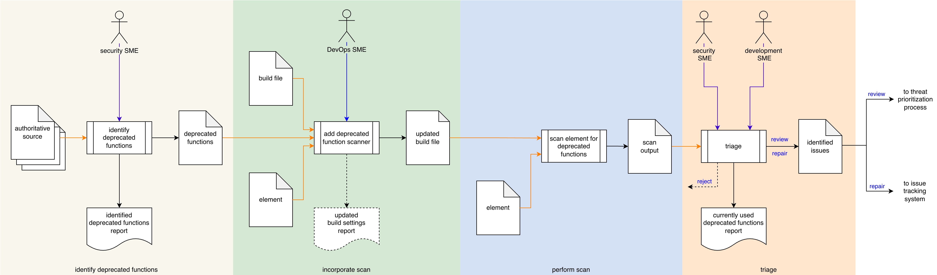
Process Workflow
Notes:
Script:
Here's the deprecated functions process which we previously covered in the Deprecated Functions Overview training.
[break]
Our focus for this training is going to be on the third activity, that of performing the scan.

Slide 5
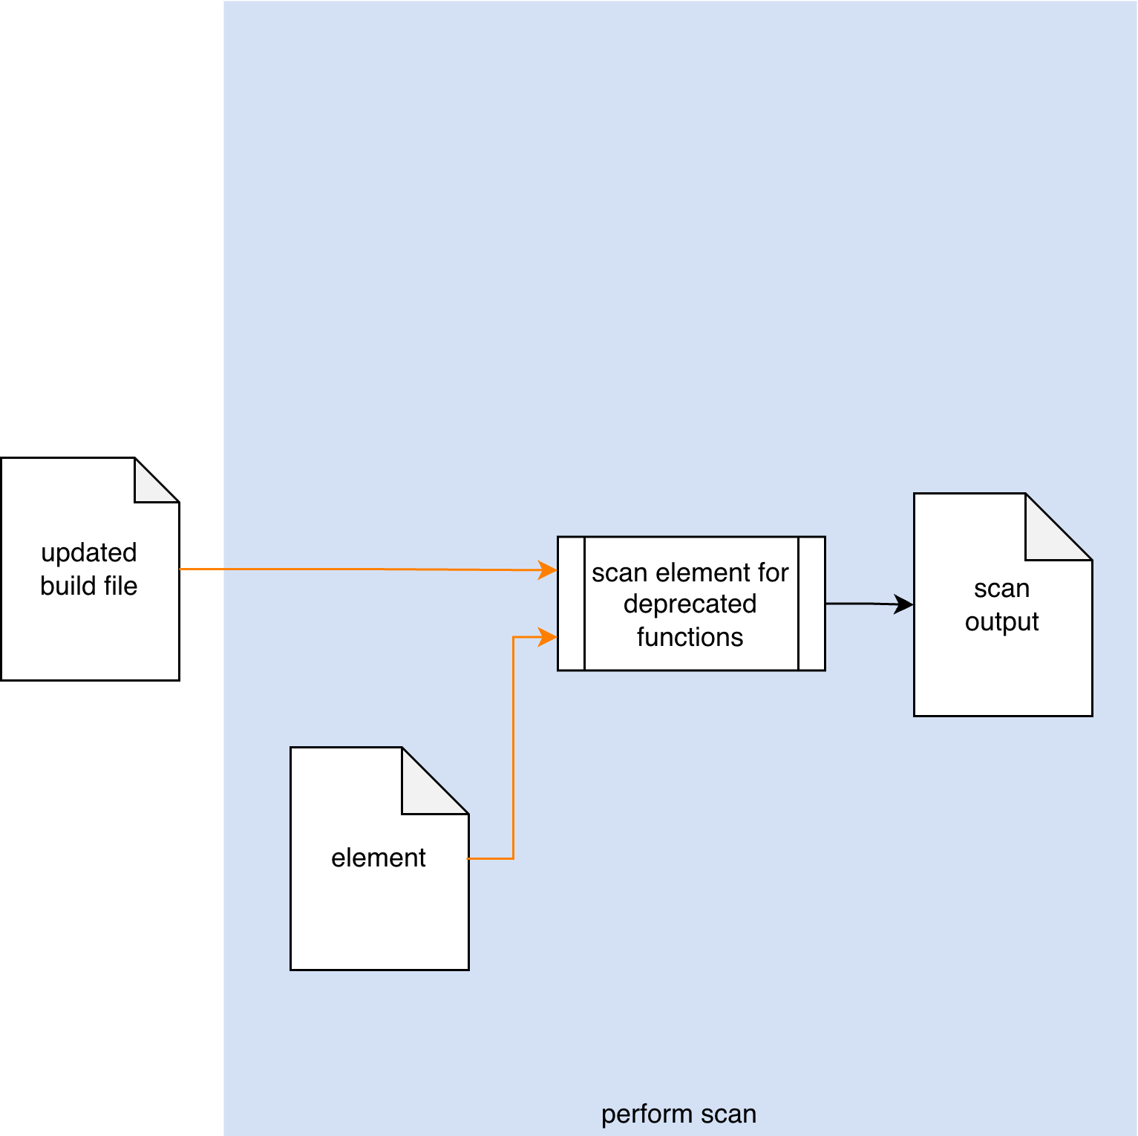
Process Workflow
Notes:
Script:
Here's the deprecated functions process which we previously covered in the Deprecated Functions Overview training.
[break]
Our focus for this training is going to be on the third activity, that of performing the scan.

Slide 6
Perform Scan
JSON-encoded SARIF
Notes:
Script:
In the perform scan activity.
[pause]
The updated build file invokes the tool used to take
[pause]
the element under consideration
[pause]
and scan for deprecated functions.
This will yield
[pause]
a scan output file.
Ideally this be done within the context of the CI/CD pipeline and without manual intervention
Now, It is possible to do this manually.
This is true with all automation.
We don't have automation until we can perform the task by hand.
And so, just because we see these activities without an explicit actor, doesn't mean that it’s not possible for someone to invoke the tooling manually.
And as a reminder, the preferred form of this scan output is a JSON-encoded SARIF, because that allows for uniform handling of cybersecurity-relevant information as it passes through the CI/CD pipeline.

Slide 7
Runtime Considerations
Notes:
Script:
One might wonder, given that we've stated that the deprecated function scanning is a hands-free activity, what the possible considerations could be.
Even given its automated nature, there is still a concern worth considering.
Let’s look at those.

Slide 8
Considerations
Execution impact
Notes:
Script:
The only point of consideration is,
[pause]
that of the impact on the build.
Even though deprecated function scanning is not a resource intensive activity, there’s still the possibility that it will perturb the build process's timing or storage constraints.
This is true regardless of whether we're talking about a build on the developer's machine or one on a dedicated build server.
Keep in mind that when scanning is performed by a stand-alone static analysis tool, that because these tools are typically backed by databases, they may have large storage needs.

Slide 9
Recap
Notes:
Script:
That covers the perform scan activity of the deprecated functions process.
Let's look at a summary.

Slide 10
Summary
Use SARIF for output
Consider the build system impact
Notes:
Script:
First,
[pause]
use SARIF for output when it's feasible.
This is a kind of futureproofing, as JSON-encoded SARIF is easily processed by Python.
This allows you to easily ingest isses into the issue tracking system.
It also can be used as feedback directly into various IDEs to facilitate mitigation by the developers themselves.
Second and most importantly,
[pause]
always consider the build system impact of the activity.
It cannot be overstated that any disruption to the build system has a severe impact on the velocity of the development teams.
And so, it should be a priority to ensure that there is sufficient headroom for tools like static analyzers to be able to perform their task without exceeding either time or space budgets.

Slide 11
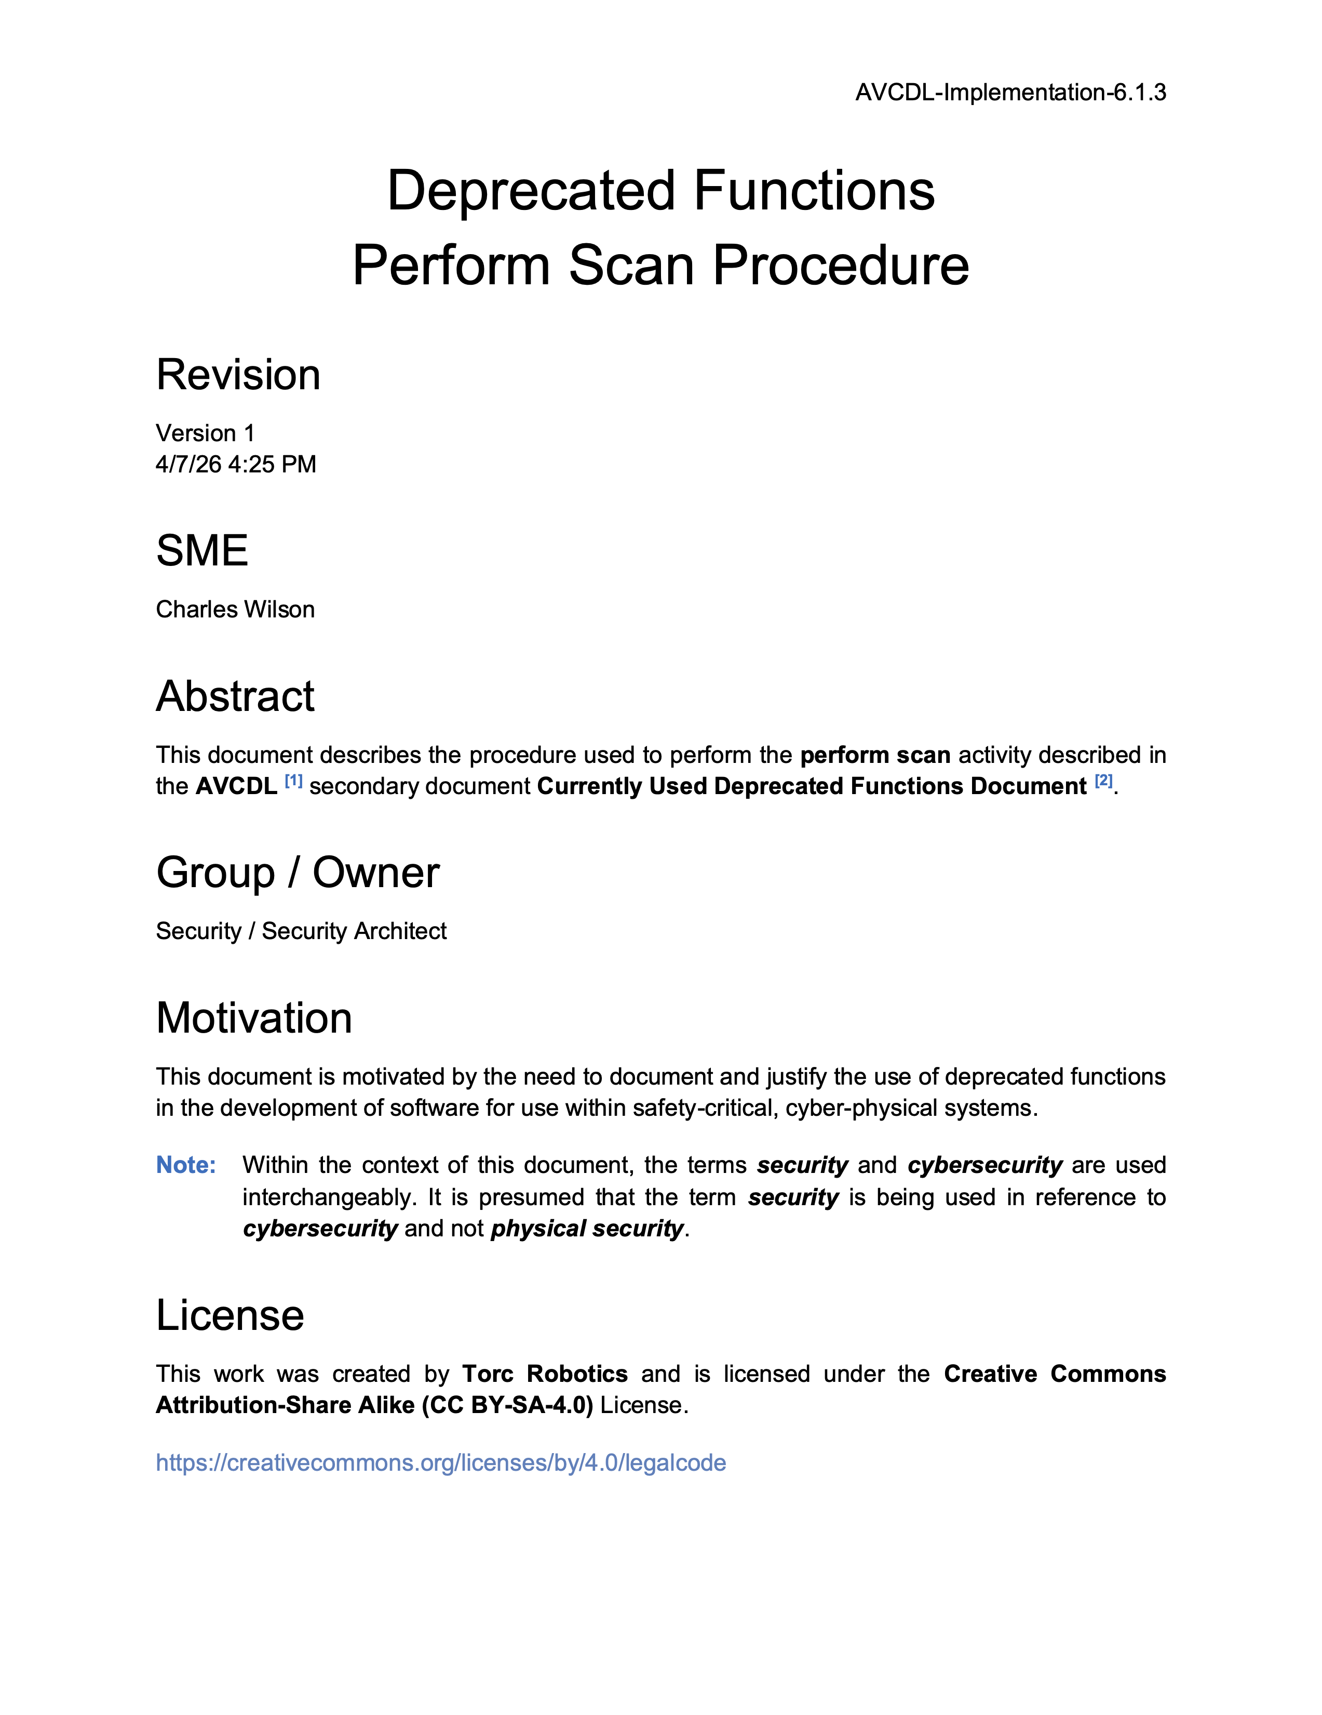
Further Reading
Notes:
Script:
For additional information and to get a more in-depth set of references, the Deprecated Functions - Perform Scan Procedure tertiary document is available in the AVCDL GitHub repository.

Slide 12
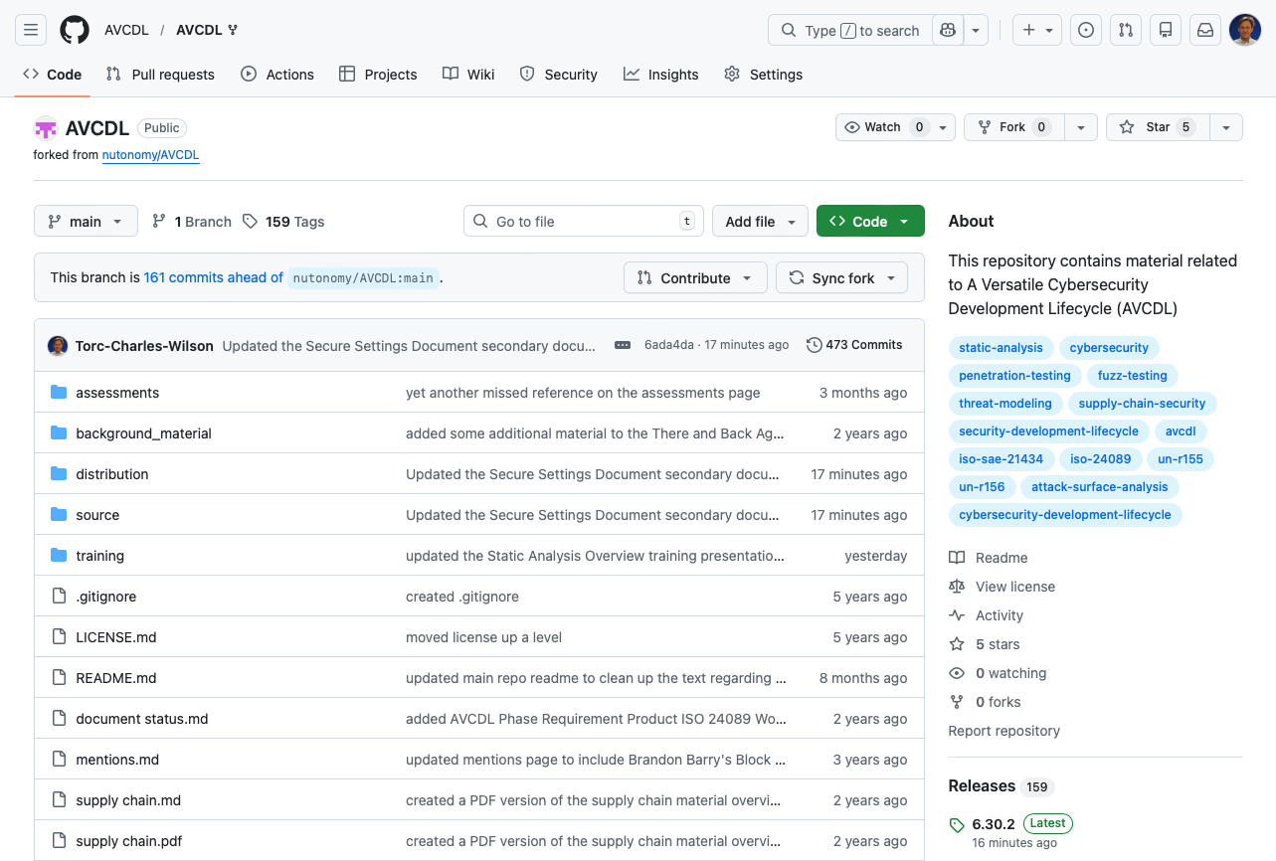
AVCDL on GitHub
https://github.com/AVCDL/AVCDL
Notes:
Script:
All AVCDL materials, both in source and distribution forms, are available on our GitHub site, as shown here.
Because of the size of the repository, it's recommended that you either clone the repository or download a ZIP archive of it, if you're not familiar with using git.
Instructions for downloading a ZIP archive are linked to on the repository’s front page.

Slide 13
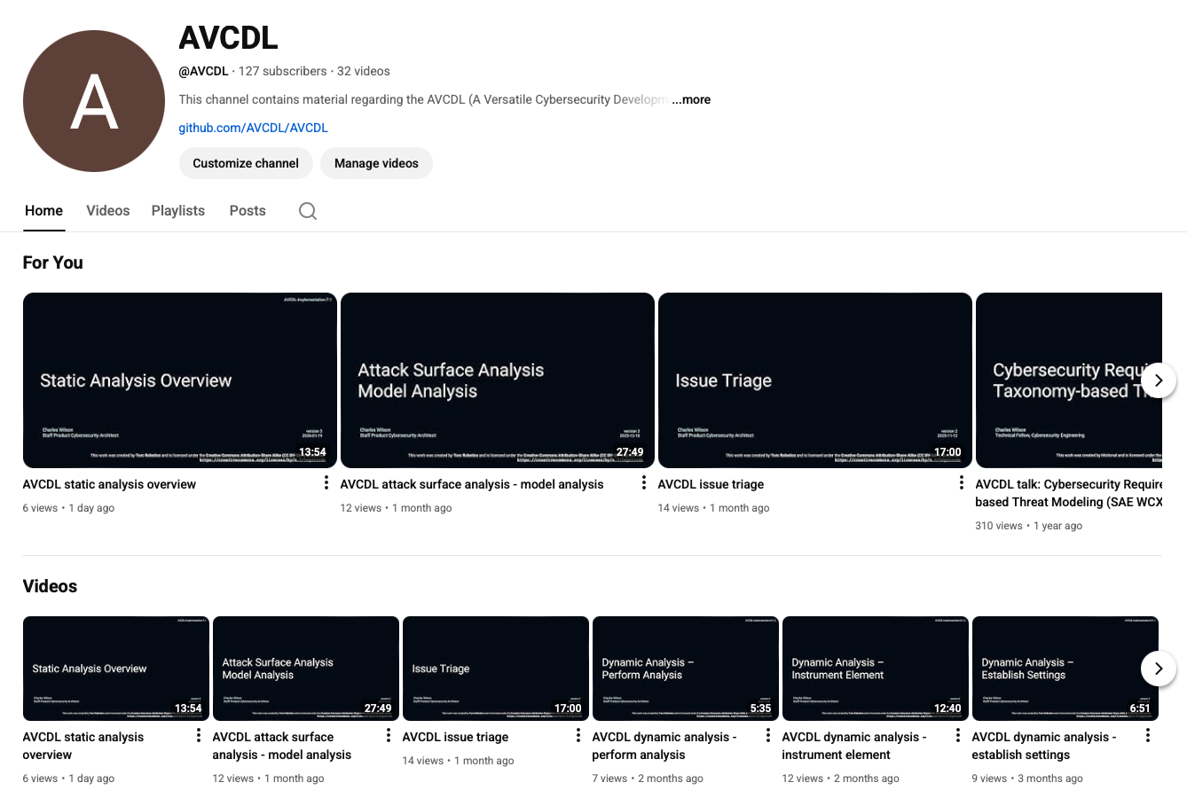
AVCDL on YouTube
https://youtube.com/@AVCDL
Notes:
Script:
Videos covering various aspects of the AVCDL are available on our YouTube channel, as shown here.
It's important to note that all AVCDL materials with the exception of the introductory blog posts are intended for product cybersecurity engineering practitioners.

Slide 14
Next Steps
Notes:
Script:
With this training complete, if you’ve completed the other trainings covering the Deprecated Functions process activities, you can proceed to the other trainings at this level, these include:
Code Reuse
and
Secure Coding

Slide 15
References
AVCDL primary document
Currently Used Deprecated Functions Document (AVCDL secondary document)
Deprecated Functions – Perform Scan Procedure (AVCDL tertiary document)
Static Analysis Results Interchange Format (SARIF) Version 2.1.0
https://docs.oasis-open.org/sarif/sarif/v2.1.0/os/sarif-v2.1.0-os.pdf
Notes:
Script:
Here are the references to the source material used in the creation of this presentation.
They'll also be included in the video description.
Additionally, this presentation’s source material will be provided on the AVCDL GitHub repository.

